Slide 1
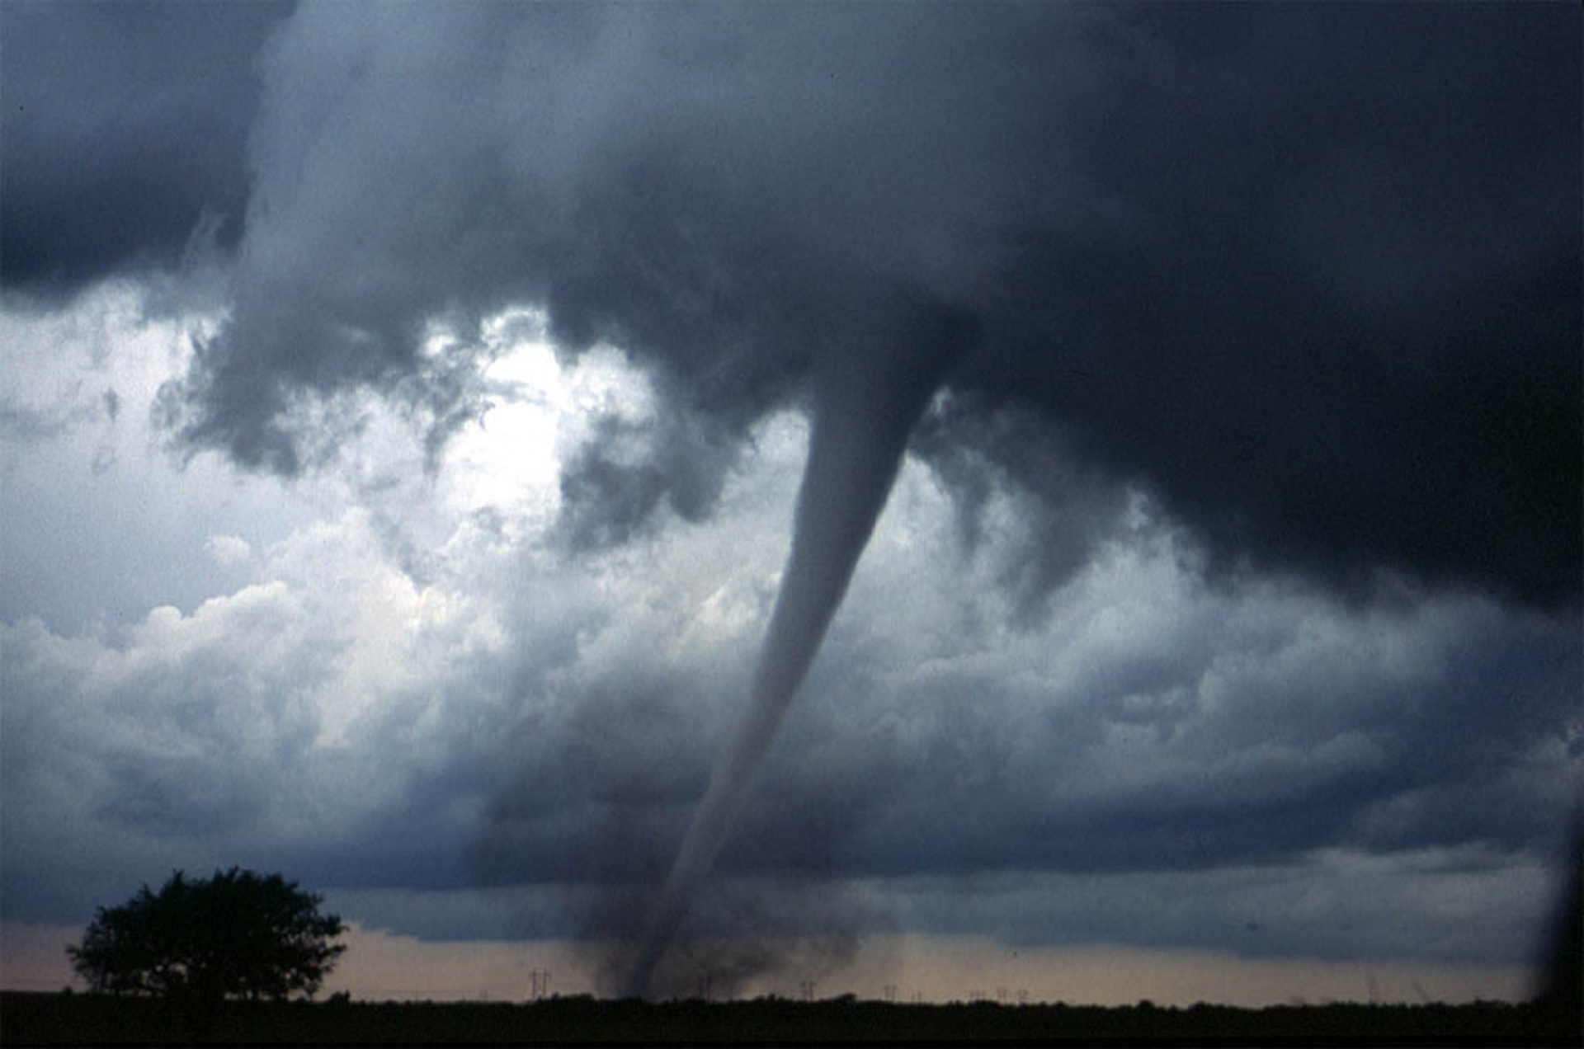
Relationship of Tornado and Thunderstorm Wind
CIS663: Developing Analytics Application
Spring 2024
Davaasuren Byambaa
M00212767

Slide 2
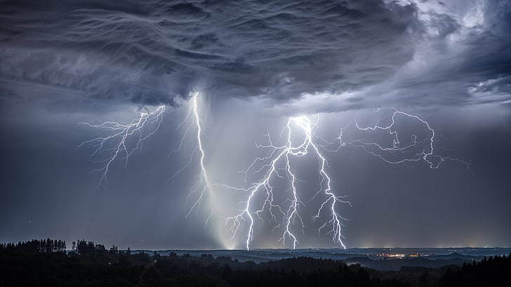
Overview
Literature Review
Theory
Data
Methodology
Result
- Reference

Slide 3
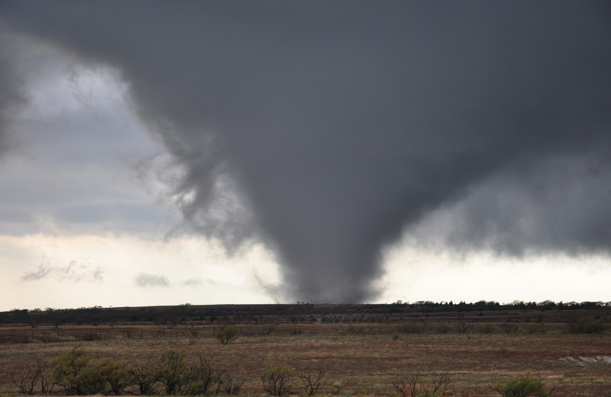
Literature Review
USA experience hundreds of Tornadoes each year, mainly in during Springtime. This vertical wind touching down from base of thunderstorm to the ground can be very violent and deadly even if its only for short time.
The key atmospheric ingredients that lead to tornado potential are instability – warm moist air near the ground, with cooler dry air aloft and wind shear – change in wind speed and/or direction with height

Slide 4
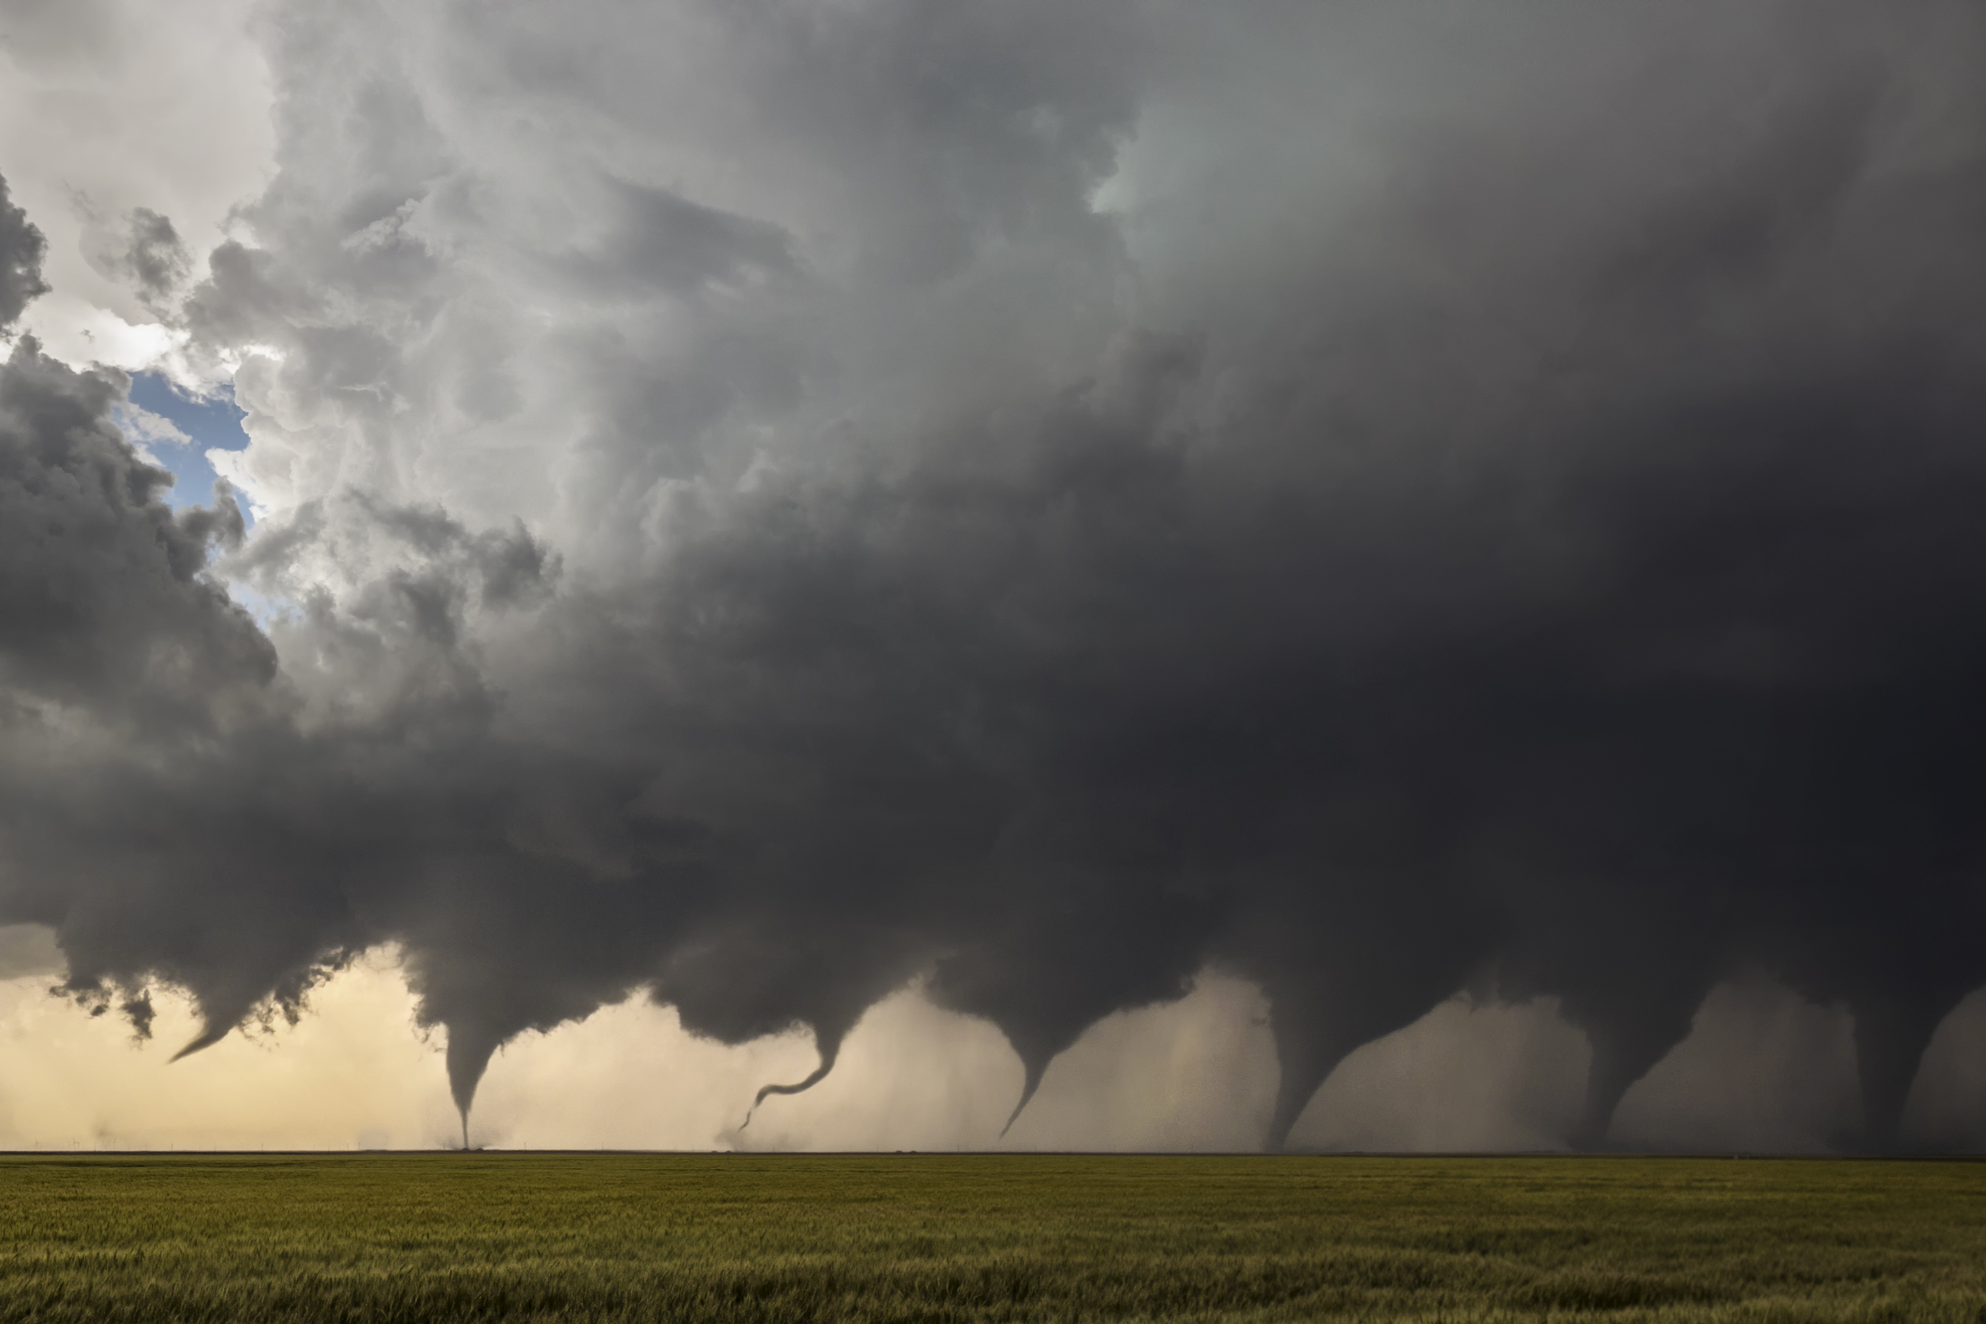
Theory
There is a positive relationship between Tornadoes and Thunderstorm Winds.

Slide 5
Data
Data is retrieved from National Oceanic and Atmospheric Administration (NOAA)
https://www.ncei.noaa.gov/pub/data/swdi/stormevents/csvfiles/
Storm events bulk data set for 2023 USA

Slide 6
Methodology
Data loaded into R using read.csv
Used dplyr package in R to clean and modify the data for analyze

Slide 7
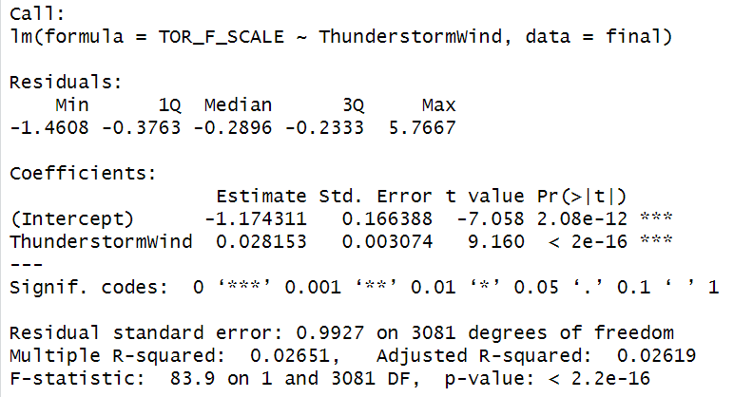
Result

Slide 8

Conclusion
Study did show that wind has statistically significant impact on formation of Tornado based on the p-value been close to 0. However, it does not support the theory wind and Tornado has positive relationship with intercept -1.174311.
I believe my linear regression with only one independent variable “Tornado Wind” was not sufficient to explain the complex situation of Tornado occurrence.
For future researchers I would suggest not to oversimplify the data as I have done here. Consider adding more independent variable such as moist/humidity, rainfall, hail fall, and temperature etc.

Slide 9
References
Tornado1651106114dvq[Online Image]. Public Domain Pictures. https://www.publicdomainpictures.net/pictures/450000/velk a/tornado-1651106114dvq.jpg
-Lightning Thunder Sky Lightning Strikes Wallpaper Preview[Online Image]. C4.Wallpaperflare. https://c4.wallpaperflare.com/wallpaper/5/528/863/lightning -thunder-sky-lightning-strikes-wallpaper-preview.jpg
-Tornado in Southwestern Oklahoma on November7,2011[Online Image]. Wikimedia. https://upload.wikimedia.org/wikipedia/commons/3/35/Torn ado_in_southwestern_Oklahoma_on_November_7,_2011.jpg
-Evolution of Tornado[Online Image]. Wikimedia. https://upload.wikimedia.org/wikipedia/commons/8/86/Evolution_of_a _Tornado.jpg
- National Oceanic and Atmospheric Administration .(2024, April 18). Storm Events. https://www.ncei.noaa.gov/pub/data/swdi/stormevents/csvfiles/

